Slide 1

DriverPass System Analysis
Angel Fernandez
Notes:
[No speaker notes required for this slide.]

Slide 2

System Requirements
Functional Requirements
The system needs to register or log users in when the correct information is needed
The system needs to be connected to the DMV to be able to display the current rules, Policies, and any samples questions to be able to practice
Non-Functional Requirements
The system needs storage for all the database and website data that is acquired
The Users need the option to reset their passwords
Notes:
[In your speaker notes, include an explanation of the different requirements you determined for DriverPass’s system. What are the functional requirements you selected to describe? What are the nonfunctional requirements you selected to describe? Be sure to explain how these requirements meet DriverPass’s needs.]

Slide 3
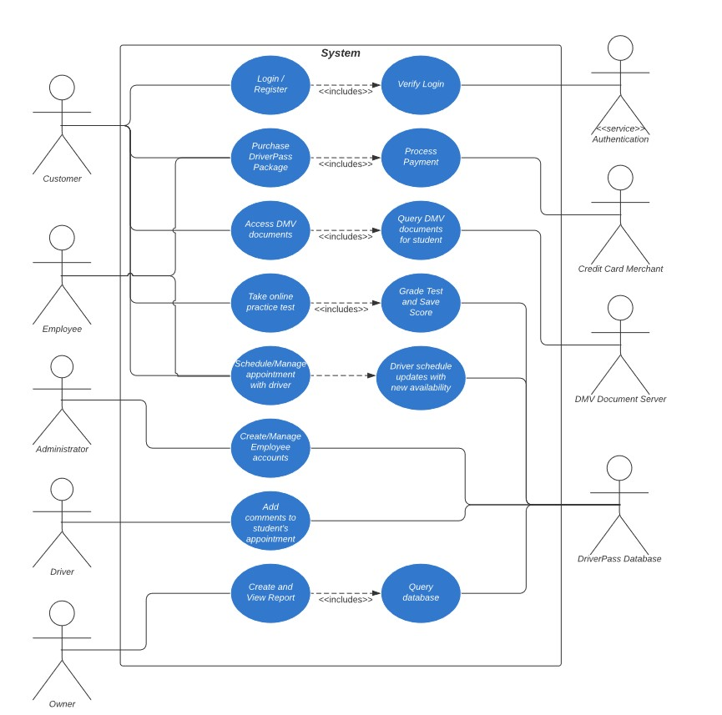
Use Case Diagram
Notes:
[Explain your diagram. Who are the different actors in the system? What are the different use cases? How did you account for DriverPass’s needs in your design? In your explanation, keep your audience in mind. Avoid the use of terms like “actors” and “use cases” in your explanation.]

Slide 4
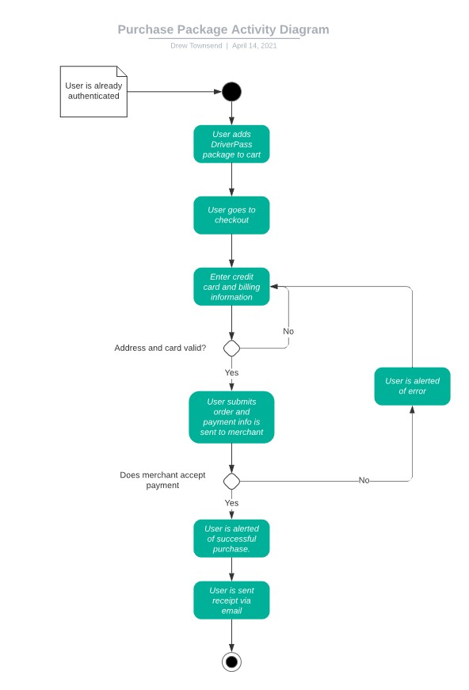
Activity Diagram
Notes:
[Explain your diagram. Which use case are you breaking down? What are the steps for this use case? How did you account for DriverPass’s needs in your design? In your explanation, keep your audience in mind. Avoid the use of technical terms such as “nodes,” “control flows,” and so on.]

Slide 5
Security
Users that are registered need to authenticate their emails.
Users need to make their own passwords to be able to login
The authorization process stops hackers from trying to enter through brute force
When on the website all data is sent as encrypted, this is done by running in HTTPS instead of HTTP
Notes:
[How did you consider security in your design? In your explanation, keep your audience in mind by avoiding the use of technical terms.]

Slide 6
System Limitations
The clients do not have a developer on staff in case something happens
Some clients may not be able to open the website
Certain regions may be slower than others
Notes:
[What are the limitations of your design? In your explanation, keep your audience in mind by avoiding the use of technical terms.]

